Slide 1
COMP3000 PROJECT
VARIANCE

Slide 2

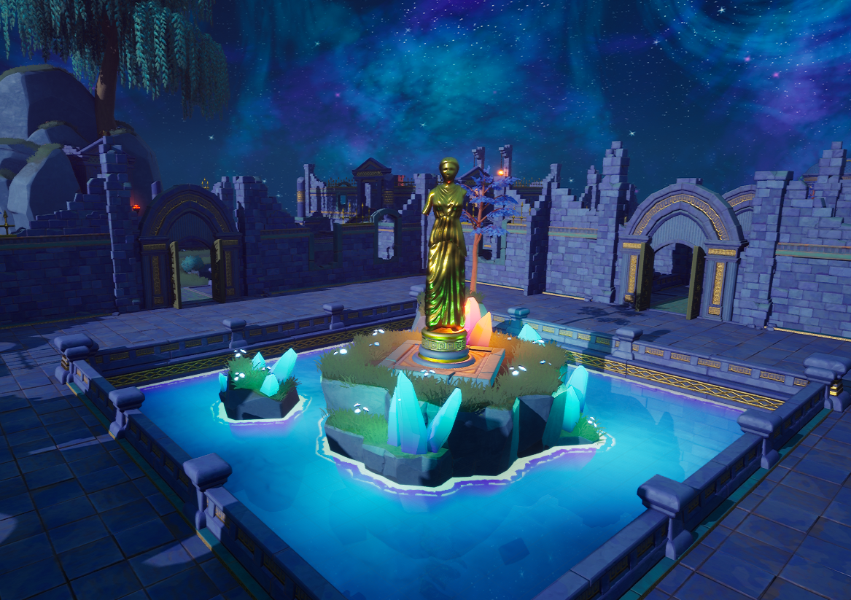
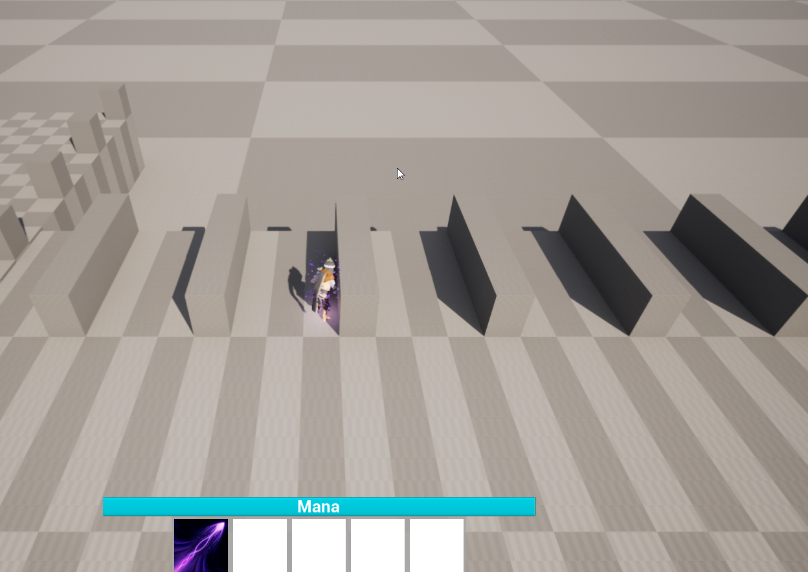
SPRINT 10 RESULTS
Added several new assets (UI, Anims, etc) (Some are placeholder)
New Animation system
New Dash system
Base framework designed for abilities – modular, instantiated
“Dynamic Camera System” – creates fluid camera motion
Prototyped UE GAS (Gameplay ability system) – No thanks
Reworked mesh generator
Added new tiles to Meadows level generation
New water shader created

Slide 3
DEMO

Slide 4
Sprint 10 reflection
Unreals GAS system would take way too long to implement and learn (really dense framework)
Multiplayer highly unlikely for deadline
Gameplay loop is being expanded upon much more rapidly
Attempted optimized-character generation approach: Resulted in broken animations, materials and cloth physics + modularity.
No AI expansion yet (Considering UE 5.1 StateTree)

Slide 5
Sprint 11 goals
Expand on UI and implement a couple abilities
Environment clipping fix – Player will be completely obscured when camera is behind object
Rework aiming system
Potentially implement the hot-swap between characters

